Slide 1
Agenda
Agile Methodology
Software Development Life Cycle
Waterfall Model & its Amendment
Need of Agile
Agile Methodology
Principles of Agile Methodology
Pillars of Agile Methodology
Agile Methodologies
Roles in Agile

Slide 2
Software Development Life Cycle
SDLC Phases
Requirement Analysis
Design
Development
Testing
Release
Maintenance
Feedback

Slide 3
Waterfall Model
Intorduction
It is also called as the classic life cycle
Waterfall Model is considered as Black Box Model
One can not go back to previous phase
Sequential in Nature
This suggests a systematic, sequential approach to software development that begins with customer specification of requirements
And progresses through
Planning
Modeling
Construction
Deployment
and Culminating in ongoing support of the completed software

Slide 4
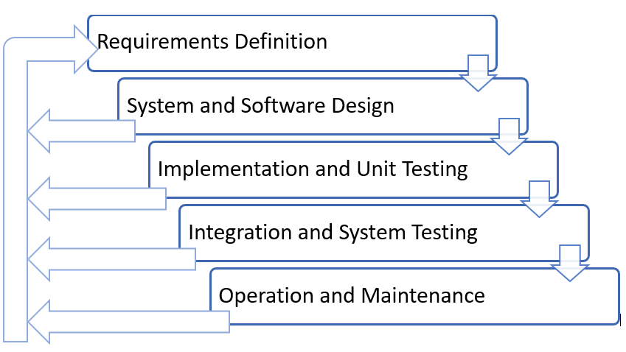
Waterfall Model Contd..
Feedback Amendment in Waterfall Model

Slide 5
Waterfall Model Contd..
Advantages
Easy to use and follow
Cost effective
Each phase completely developed
Development processed in sequential manner, so very less chance of rework
Easy to manage the project
Easy documentation

Slide 6
Waterfall Model Contd..
Waterfall Model Problems
The main drawback of the waterfall model is the difficulty of accommodating change after the process is underway
In principle, a phase has to be complete before moving onto the next phase
Inflexible partitioning of the project into distinct stages makes it difficult to respond to changing customer requirements
Therefore, this model is only appropriate when the requirements are well-understood and changes will be fairly limited during the design process
Few business systems have stable requirements

Slide 7
Need of Agile
Why Agile?
The project will produce the wrong product
The project will produce a product of inferior quality
The project will be late
We’ll have to work 80 hour weeks
We’ll have to break commitments
We won’t be having fun
Storm called Agile
According to VersionOne's State of Agile Report in 2017 says 94% of organizations practice Agile, and in 2018 it reported 97% organizations practice agile development methods

Slide 8
Agile Methodology Contd..
Agile – Background
Agile was formally launched in 2001
17 technologists drafted the Agile Manifesto
Kent Beck
Mike Beedle
Ken Schwaber
Jeff Sutherland
Dave Thomas
Arie van Bennekum
Alistair Cockburn
Ward Cunningham
Martin Fowler
James Grenning
Jim Highsmith
Andrew Hunt
Ron Jeffries
Jon Kern
Brian Marick
Robert C. Martin
Steve Mellor

Slide 9
Principles of Agile Methodology
Twelve Principles
Our highest priority is to satisfy the customer through early and continuous delivery of valuable software
Welcome changing requirements, even late in development. Agile processes harness change for the customer's competitive advantage
Deliver working software frequently, from a couple of weeks to a couple of months, with a preference to the shorter timescale
Business people and developers must work together daily throughout the project
Build projects around motivated individuals. Give them the environment and support they need, and trust them to get the job done
The most efficient and effective method of conveying information to and within a development team is face-to-face conversation
Working software is the primary measure of progress
Agile processes promote sustainable development. The sponsors, developers, and users should be able to maintain a constant pace indefinitely
Continuous attention to technical excellence and good design enhances agility
Simplicity--the art of maximizing the amount of work not done--is essential
The best architectures, requirements, and designs emerge from self-organizing teams
At regular intervals, the team reflects on how to become more effective, then tunes and adjusts its behavior accordingly

Slide 10
Pillars of Agile Methodology
Agile focuses on
Individuals and interactions
Processes and tools
Working software
Comprehensive documentation
Customer Collaboration
Contract negotiation
Responding to change
Following a plan

Slide 11
Agile Methodologies
Few of Agile Methodologies
Scrum
Extreme Programming [XP]
Test driven Development [TDD]
Feature Driven Development [FDD]
Behavior-driven development [BDD]

Slide 12
Roles in Agile
Basic roles involved
User
Product Owner
Software Development Team

Slide 13
Operational Methodology
ITIL
ITIL is a framework of best practices for delivering IT services
The ITIL processes within IT Service Management (ITSM) ensure that IT Services are provided in a focused, client-friendly and cost-optimized manner
ITIL’s systematic approach to IT service management can help businesses
Manage risk
Strengthen customer relations
Establish cost-effective practices
And build a stable IT environment
that allows for
Growth
Scale and
Change

Slide 14
ITIL
ITIL : Origin
Developed by the British government's Central Computer and Telecommunications Agency (CCTA) during the 1980s
The ITIL first consisted of more than 30 books, developed and released over time, that codified best practices in information technology accumulated from many sources (including vendors' best practices) around the world
ITIL’s contribution aligned with the ISO/IEC 20000 Service Management standard in 2005
Since 2013, ITIL is owned by Axelos — a joint venture between the Cabinet Office and Capita

Slide 15
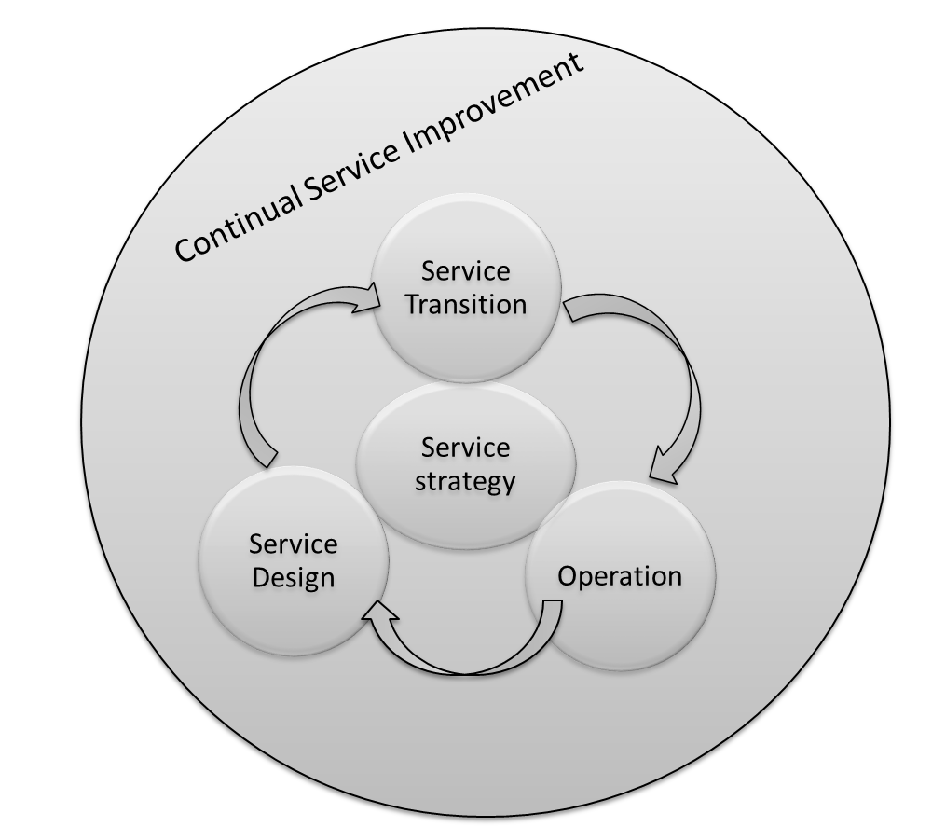
ITIL
IT Service Management (ITSM) Lifecycle
ITIL views ITSM as a lifecycle
Five Phases:
Service Strategy [design, development, and implementation]
Service Design [design and development]
Service Transition [development and design]
Service Operation [delivery and support]
Service Improvement [create and maintain value]

Slide 16
ITIL Framework
Service Strategy
Demand Management
Business Relationship management
Service Design
Service level Management
Continuity Management
Service portfolio Management
Financial Management
Supplier Management
Capacity Management
Availability management
Information Security Management
Service catalogue Management
Design Coordination
Service Transition
Transition Planning and support
Knowledge Management
Service Operation
Event Management
Incident Management
Change Management
Asset and Configuration management
Service validation and testing
Release and Deployment Management
Evaluation
Problem Management
Request Fulfilment
Access Management
Service Desk
Technical Management
Application Management
IT Operations
CSI

Slide 17
ITIL
ITIL: Is a Project?
ITIL is not a “Project”
ITIL is ongoing journey
Benefits of ITIL:
Organizations to reduce the operations cost by optimizing the available resource utilizations
Reduce system outages and minimize the impacts of service unavailability
Even most organizations testified with reduction in business critical incidents by 80 to 90% in few years

Slide 18
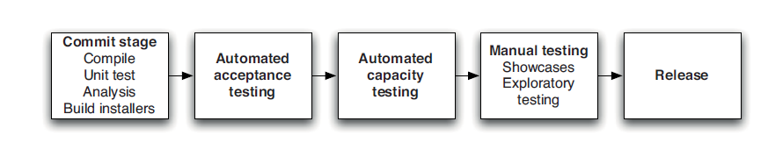
Problems of Delivering Software
Converting Idea to Product / Service?
Reliable, rapid, low-risk software releases
Ideal Environment
Generic Methodologies for Software Methodologies
More focus on Requirement Gathering

Slide 19
Problems of Delivering Software
Release Antipatterns
Common Quote “The day of a software release tends to be a tense one”
Antipattern: Deploying Software Manually
The production of extensive and detailed documentation for steps to be performed
Reliance on manual testing
Frequent calls to the development team to explain
Frequent corrections to the release process
Sitting bleary-eyed in front of a monitor at 2 A.M

Slide 20
Problems of Delivering Software
Release Antipatterns Cond..
Antipattern: Deploying to a Production-like Environment Only after Development Is Complete
Tester tested the system on development machines
Releasing into staging is the first time that operations people interact with the new release
Who Assembles? The Development Team
Collaboration between development and Operations?
Antipattern: Manual Configuration Management of Production Environments
Difference in Deployment to Stage and Production
Different host behave differently
Long time to prepare an environment
Cannot step back to an earlier configuration of a system
Modification to Configuration Directly

Slide 21
Continuous Delivery
Introduction to Continuous Delivery
Promotes the adoption of an automated deployment pipeline to release software into production reliably and quickly
Its goal is to establish an optimized end-to-end process, enhance the development to production cycles, lower the risk of release problems and provide a quicker time to market
To that point, Jez Humble and Dave Farley define the 8 principles of continuous delivery in their Book “Continuous Delivery” as:

Slide 22
Principle of Continuous Delivery
Build Repeatable and Reliable Process
Use the same release process in all environments
If a feature or enhancement has to work through one process on its way into the integration environment, and another process into QA, issues find a way of popping up

Slide 23
Principle of Continuous Delivery
Try to Automate Everything
Automate builds, testing, releases, configuration changes and everything else
Manual processes are inherently less repeatable, more prone to error and less efficient
Once we automate a process, less effort is needed to run it and monitor its progress – and it will ensure to have consistent results

Slide 24
Principle of Continuous Delivery
Keep everything in Version Control
Have one source of truth
Keep Code, configuration, scripts, databases, documentation and everything versioned

Slide 25
Principle of Continuous Delivery
Bring the Pain Forward
Deal with the hard stuff first
Time-consuming or error prone tasks should be dealt with as soon as you can
Once you get the painful issues out of the way, the rest will most likely be easier to perfect

Slide 26
Principle of Continuous Delivery
Ensure Quality – in Build
Create short feedback loops to deal with bugs as soon as they are created
By having issues looped back to developers as soon as they fail post-build test, it will enable them to produce higher quality code quicker
In addition, fewer issues will be found later on in the process, when it will be more expensive to fix

Slide 27
Principle of Continuous Delivery
Set expectation as "Done" means Released
A feature is done only when it is in production
Having a clear definition of “done” right from the start will help everyone communicate better, and realize the value in each feature

Slide 28
Principle of Continuous Delivery
Everyone is Responsible
"It works on my workstation" is never a valid excuse
Responsibility should extend all the way to production
Cultural change can be the hardest to implement
However, having management support and an enthusiastic champion will certainly help

Slide 29
Principle of Continuous Delivery
Continuous Improvement
This principle is the most important for effective automation
If "practice makes perfect" then automation represents the ultimate expression of a practice-making-perfect iterative process.

Slide 30
Principle of Continuous Delivery
Summary
Create a Repeatable, Reliable Process for Releasing Software
Automate Almost Everything
Keep Everything in Version Control
If It Hurts, Do It More Frequently, and Bring the Pain Forward
Build Quality In
“The Earlier you catch the defects, the cheaper they are to fix”
Done, Means Released
Everybody Is Responsible for the Delivery Process
Continuous Improvement

Slide 31
DevOps Basics
Introduction
A clipped compound of Development and Operations
Buzzword
Innovation for automation (pillar of DevOps)
DevOps is an approach based on lean and agile principles
There are more tangential DevOps Initiative
WinOps
DevSecOps
BizDevOps

Slide 32
DevOps Basics
Introduction Contd..
Definition of DevOps:
“DevOps is a set of practices intended to reduce the time between committing a change to a system and the change being placed into normal production, while ensuring high quality”
Implications of this definition
Practices and tools
Do not restricted scope of DevOps to testing and development

Slide 33
DevOps Basics
Need for DevOps
Developer :- Writing Code
Quality Assurance :- Testing
Operations personnel :- Deploy
QA
Operator
Code

Slide 34
DevOps Basics
Need for DevOps Contd..
Developer
Tester
Operator
BUG
FIX
When

Slide 35
DevOps Basics
Need for DevOps Contd..
Product Release
Feature A
Feature B
Existing Bugs
Bug 1
Bug 2
New Features
Bug Fix

Slide 36
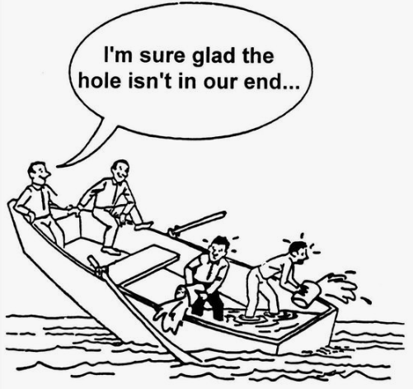
DevOps Basics
Need for DevOps Contd..
https://in.pinterest.com/

Slide 37
DevOps Basics
Need for DevOps Contd..
Waterfall Model
Dominated Project Management Until 2001
Still in Use :
Disciplined Approach
Thorough Scoping
Clear Stages
Concrete Deadlines
Disadvantages:
Sequential
Inflexible
Assumptions
We are loosing Time to market

Slide 38
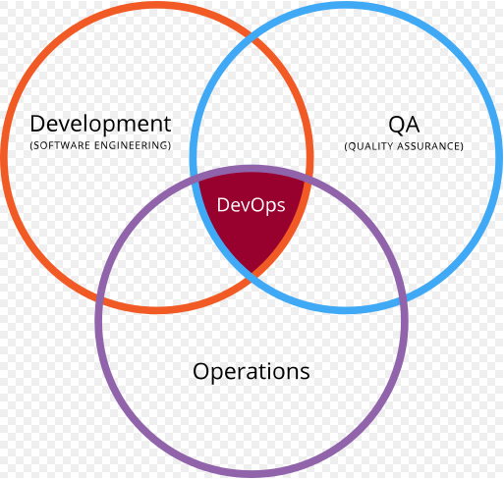
DevOps Basics
Where is Operations?
Development is All Well
Where is Operations?
Where is System Administrators?

Slide 39
DevOps Basics
Why DevOps? :: Lets Summaries
Release Process
Releasing a new system or version of an existing system to customers is one of the most sensitive steps in the software development cycle
The following release planning steps are adapted from Wikipedia
Define and agree on release and deployment plans with customers/stakeholders
Ensure that each release package consists of a set of related assets and service components that are compatible with each other
Ensure that the integrity of a release package and its constituent components is maintained throughout the transition activities and recorded accurately in the configuration management system
Ensure that all release and deployment packages can be tracked
Poor Coordination
Limited Capacity of Operations Staff

Slide 40
DevOps Practices
Five different categories of DevOps practices
Treat Ops as first-class citizens from the point of view of requirements
Make Dev more responsible for relevant incident handling
Enforce the deployment process used by all, including Dev and Ops personnel
Use continuous deployment
Develop infrastructure code, such as deployment scripts

Slide 41
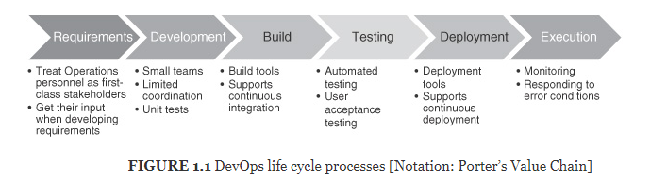
DevOps Practices
DevOps life cycle processes by Porter’s value chain

Slide 42
DevOps Practices
Common terminology used
IT professional
help desk support
operator, and operations personnel
hands-on access to the hardware—installing and configuring hardware, managing backups, and maintaining printers
System administrator
responsible for uptime, performance, resources, and security of computer systems
Note :We will use term operator though out the course refer to anyone who performs computer operator or system administration tasks (or both)

